Slide 1
Experiment -07
Process Synchronization using Semaphore/-
Mutex

Slide 2
Background
Co-Operating Process: that can affect or be affected by other processes executing in system
Concurrent access to shared data may result in data inconsistency
Process Synchronization: Ensures coordination among processes and maintains Data Consistency
Synchronization
Process or thread synchronization refers to the coordination and orderly execution of concurrent processes or threads in a multi-threaded or multi-process system.
Notes:
2

Slide 3
Race Condition
When multiple processes access and manipulate the same data at the same time, they may enter into a race condition.
Race Condition: When output of the process is dependent on the sequence of other processes.
Race Condition occurs when processes share same data
Process P1 Process P2
1. reads i=10
2. i=i+1 =11
1. P2 reads i=11 from memory 2. i=i+1 = 12
3. Stores i=11 in memory 3. Stores 12 in memory
Notes:
3

Slide 4
Critical Section Problem
Section of code or set of operations, in which process may be changing shared variables, updating common data.
A process is in the critical section if it executes code that manipulate shared data and resources.
Each process should seek permission to enter its critical section→ Entry Section
Exit Section
Remainder section: Contains remaining code
Notes:
4

Slide 5
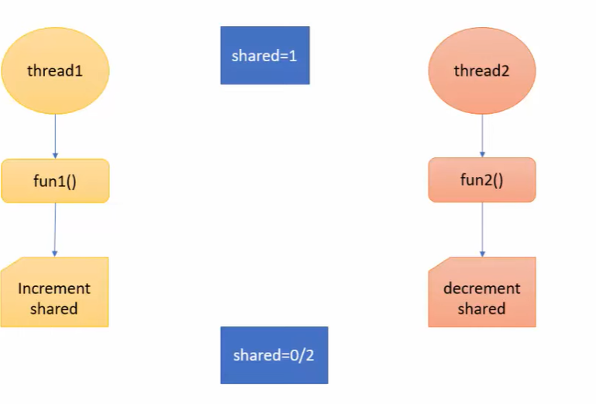
Race Condition

Slide 6
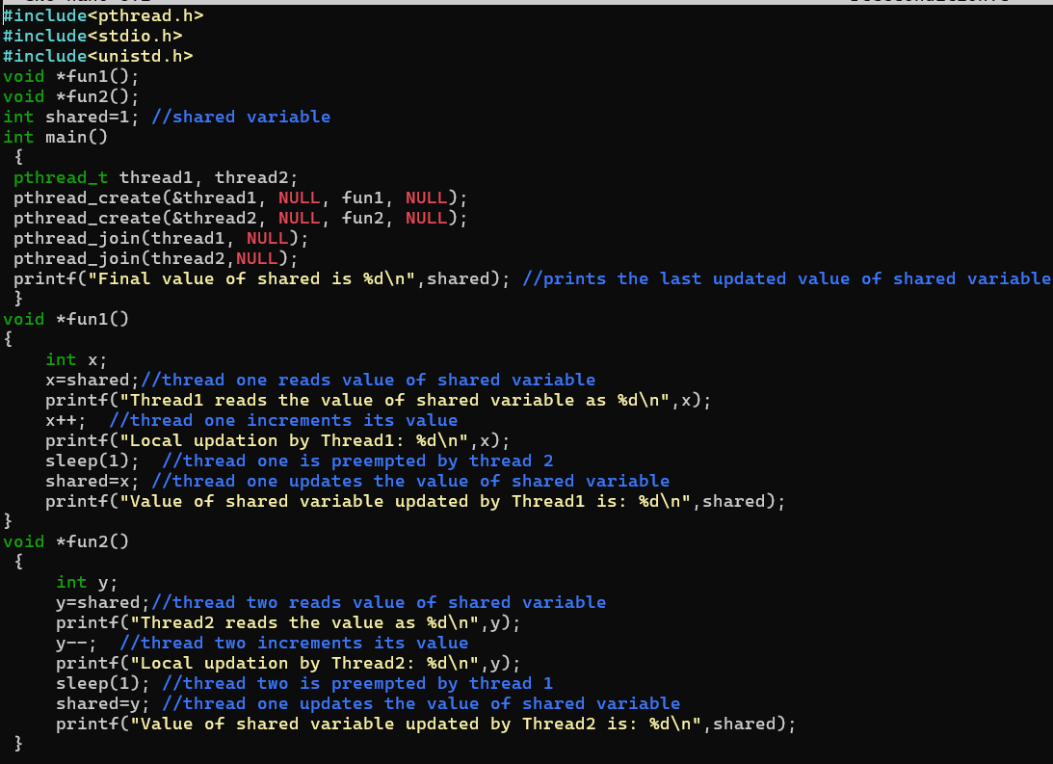
Write a c-program to create the Race Condition

Slide 7
Semaphore
Synchronization tool that maintains concurrency using variables
Semaphore S is a integer variable which can take positive values including 0. It is accessed from 2 operations only.
Operations On Semaphore:
wait() and signal()
1. Wait Operation is also known as P() which means to test
2. Signal Operation is also known as V() which means to increment
Entry to C.S. is controlled by wait()
Exit from C.S. is signaled by signal()
Notes:
7

Slide 8
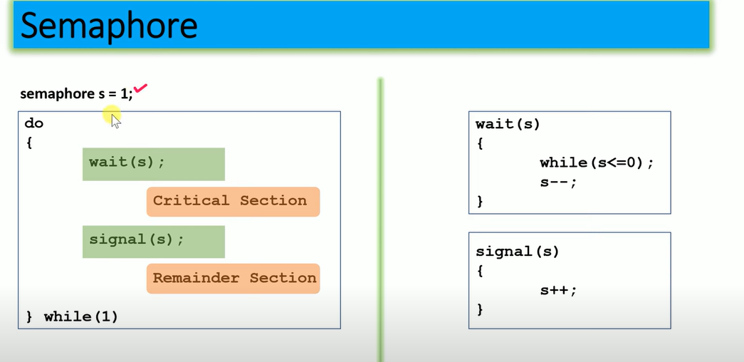
Process Synchronization using Semaphore
Notes:
8

Slide 9
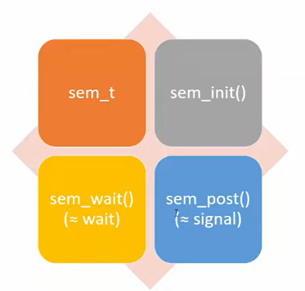
System Call Function Used in Process Synchronization

Slide 10
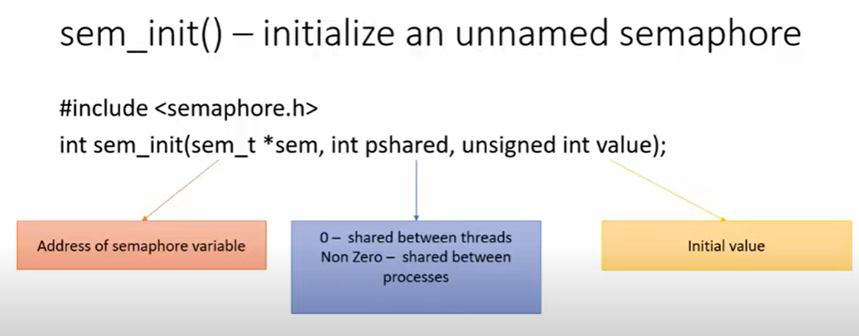

Slide 11
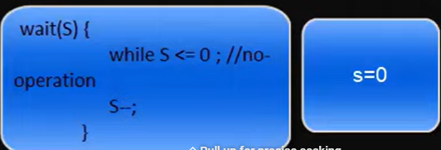
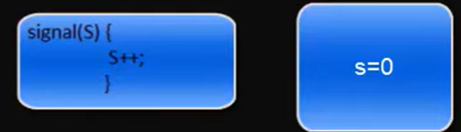
How wait and signal function works

Slide 12
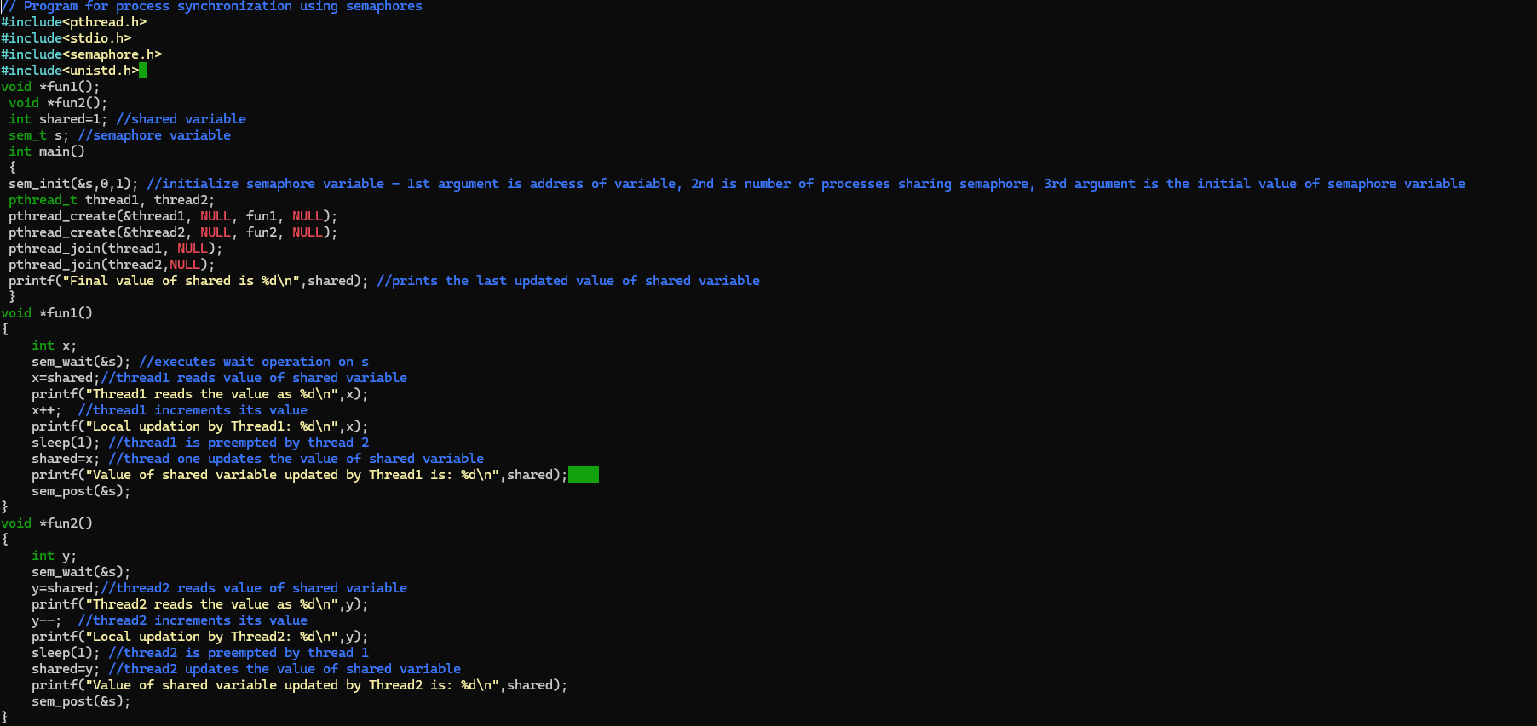
Write a c-program of Process Synchronization using Semaphore

Slide 13
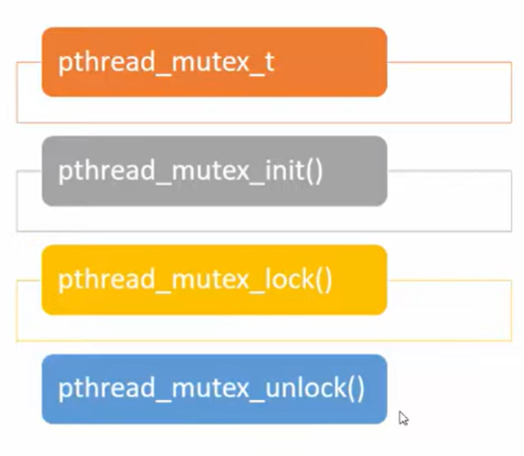
Process Synchronization using Mutex

Slide 14
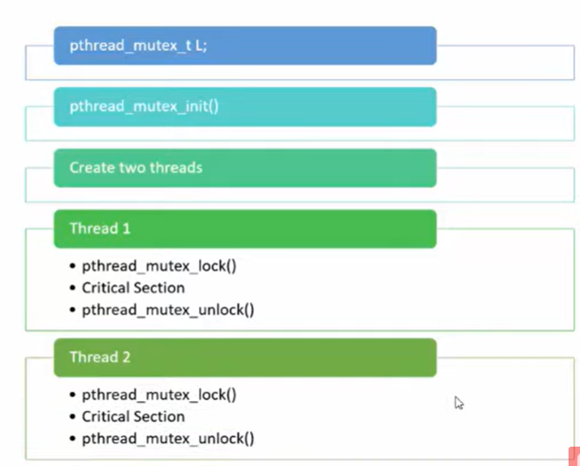
Program Flow

Slide 15
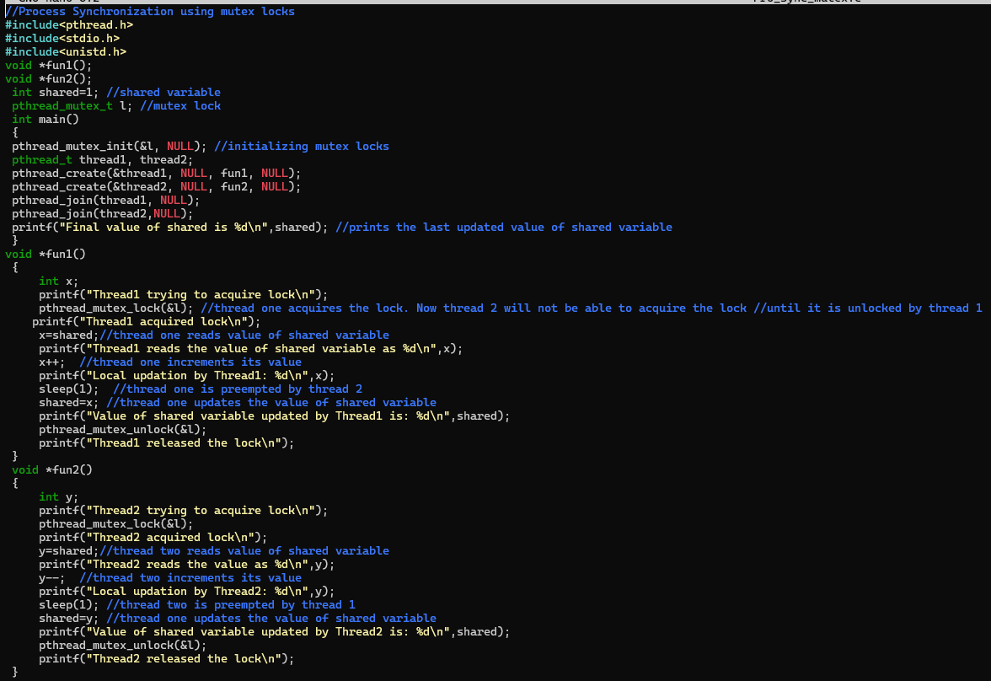
Write a c-program of Process Synchronization using Semaphore

